Slide 1
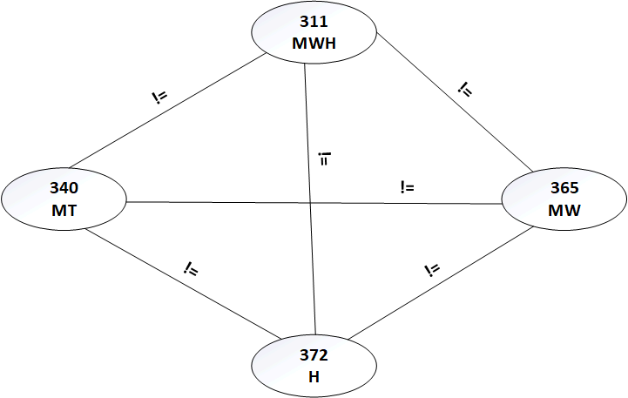


Example Constraint Network

Slide 2
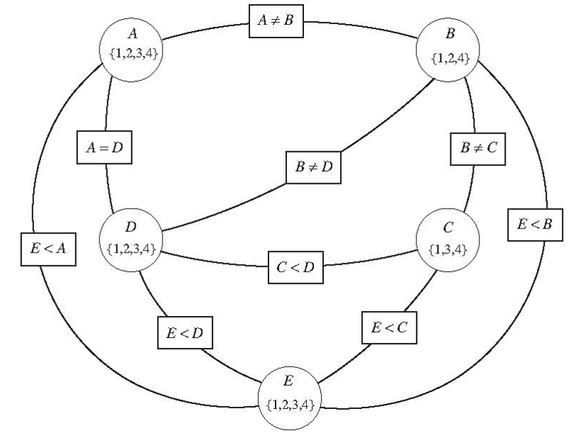
Example Constraint Network

Slide 3
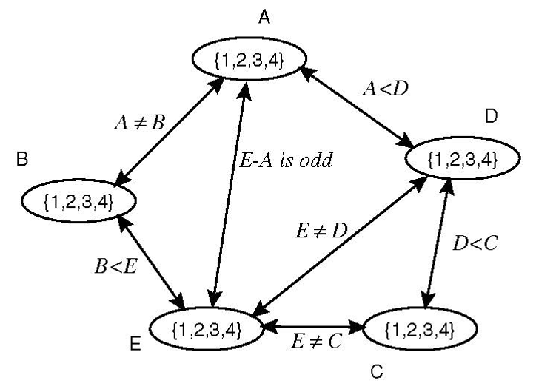
Example Constraint Network II
Labeled edges between nodes, all nodes are variables

Slide 4
Network II – Let’s Do This
Labeled edges between nodes, all nodes are variables

Slide 5
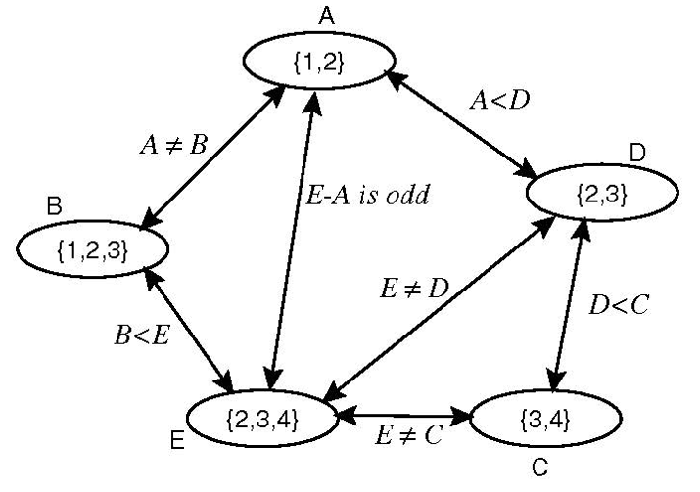
Arc-Consistent network

Slide 6
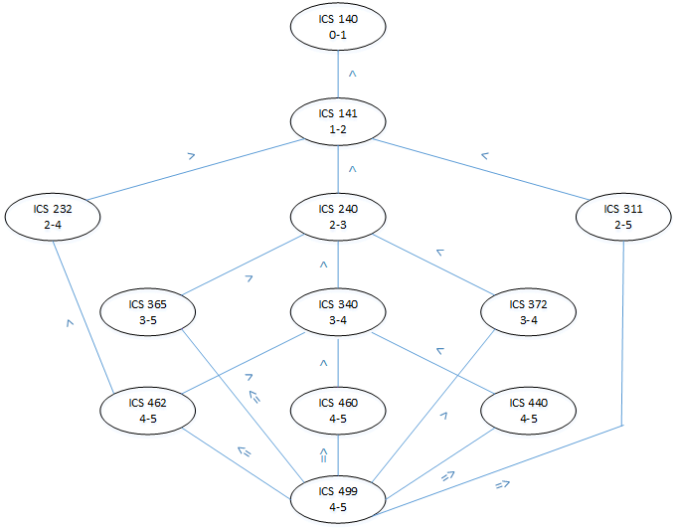
Network for CS major Prerequisites

Slide 7
Generalized Arc Consistency Algorithm
A way to systematically prune the domains of some of the variables.
It may not give a complete answer, but it’s a quick way to get part way there.
It may also identify impossibilities.

Slide 8
GAC
Let V be the set of vertices D be the set of variable domains, and C be the set of constraints.
1: procedure GAC(⟨V,D,C ⟩) 2: // Returns arc consistent domains for CSP ⟨V, D, C⟩ 3: return GAC2( (V, D, C), {⟨X,c⟩ | c ∈ C and X ∈ scope(c) } ) 4: procedure GAC2(⟨V, D, C⟩, to_do ) 5: while to_do ≠ ∅ do 6: select and remove ⟨X,c⟩ from to_do 7: let {Y₁, …, Y_{k} } = scope(c) \ {X} 8: ND := { x | x ∈ D_{X} and ∃ y₁ ∈ D_{Y1}, …, y_{k} ∈ D_{yk} such that c(X=x, Y₁=y₁,…,,_{k}=y_{k})} 9: if ND ≠ D_{X} then 10: to_do := to_do ∪ {⟨Z,c’⟩ | {X,Z} ⊆ scope(c’), c’ ≠ c, Z ≠ X} 11: D_{X} := ND 12: return D

Slide 9
Sample GAC Run (all domains initially {1,2,3,4})
Activity | To_do ⟨v,c⟩ | D_{A} | D_{B} | D_{C}
Initial | ⟨A,A<B⟩, ⟨B,A<B⟩, ⟨B,B<C⟩, ⟨C,B<C⟩ | {1,2,3,4} | {1,2,3,4} | {1,2,3,4}
Select ⟨A,A<B⟩. If A = 4, no B satisfies c, D_{A} := D_{A}\{4}. Nothing to add to to_do. | ⟨B,A<B⟩, ⟨B,B<C⟩, ⟨C,B<C⟩ | {1,2,3} | {1,2,3,4} | {1,2,3,4}
Select ⟨B,A<B⟩. If B = 1, no A satisfies c, D_{B} := D_{B}\{1}. Nothing to add to to_do. | ⟨B,B<C⟩, ⟨C,B<C⟩ | {1,2,3} | {2,3,4} | {1,2,3,4}
Select ⟨B,B<C⟩. If B = 4, no C satisfies c, D_{B} := D_{B}\{4}. Nothing to add to to_do. B changed, add ⟨A,A<B⟩ to to_do (may need to change A) | ⟨C,B<C⟩, ⟨A,A<B⟩ | {1,2,3} | {2,3} | {1,2,3,4}
Select ⟨C,B<C⟩. IF C = 1 or C = 2, no B satisfies c, D_{C} := D_{C} \ {1,2}. No other constraint contains C, nothing to add to to_do. | ⟨A,A<B⟩ | {1,2,3} | {2,3} | {3,4}
Select ⟨A,A<B⟩. If A = 3, no B satisfies c, D_{A}:= D_{A}\{3}. No other constraint contains A. Done. |  | {1,2} | {2,3} | {3,4}

Slide 10
Variable Elimination (I)
Idea: Eliminate the variables one by one, passing their constraints to their neighbors
Variable Elimination Algorithm:
If there is only one variable, return the intersection of the (unary) constraints that contain it
Select a variable X
Join the constraints in which X appears, forming constraint R₁.
Project R₁ onto its variables other than X, forming R₂
Replace all of the constraints in which X appears by R₂
Recursively solve the simplified problem, forming R₃.
Return R₁ joined with R₃

Slide 11
Variable Elimination (II)
When there is a single variable remaining, if it has no values, the network was inconsistent.
The variables are eliminated according to some elimination ordering.
Different elimination orderings result in different size intermediate constraints.

Slide 12
Network for Variable Elimination

Slide 13
Make Network Arc-consistent

Slide 14
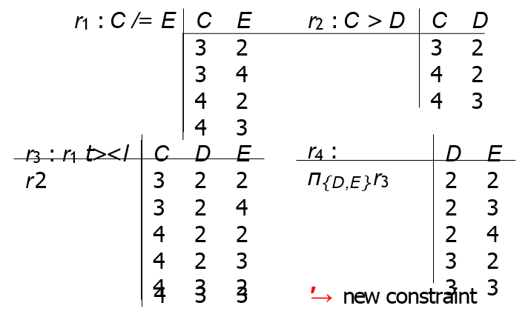
Eliminating C

Slide 15
Eliminating C (detail 1)

Slide 16
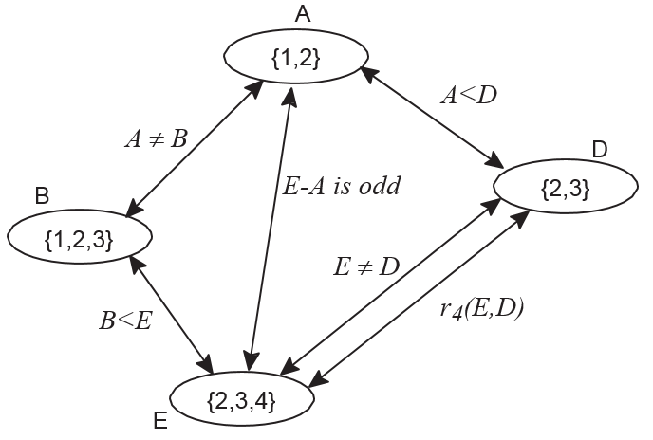
Eliminating C (detail 2)

Slide 17
Local Search I
Previous methods are deterministic. But for large problems they may be unwieldy.
Especially for optimization problems, it can be a good idea to start with a proposed solution then tweak it to try to find a better solution.
The idea of Local Search is to start with a proposed solution to a problem, and modify it – sometimes randomly.
Find a valid solution to a problem with only hard constraints
Find a better solution to an optimization problem

Slide 18
Local Search II
Maintain an assignment of a value to each variable.
Repeat:
Select a variable to change
Select a new value for that variable
Check if you have a solution
Until a satisfying assignment is found.
Often uses one of these methods that we discuss:
Greedy descent
Continuous domains
Iterative best improvement (IBI)
Discrete domains

Slide 19
Local Search III
1: procedure Local_search(V, D, C)
2: Inputs
3: Vs a set of variables
4: D: a function such that D_{X} is the domain of variable X
5: C: set of constraints to be satisfied
6: Output
7: total assignment that satisfies the constraints
8: Local
9: A an array of values indexed by variables in V
10: repeat
11: for each variable X in V do // Random restart
12: A[X]:= a random value in D_{X}
13: while not stop_walk()& A is not a satisfying assignment do // local search
14: Select a variable Y and a value w ∈ D_{Y}
15: Set A[Y]:=w
16: if A is a satisfying assignment then
17: return A
18: until termination

Slide 20
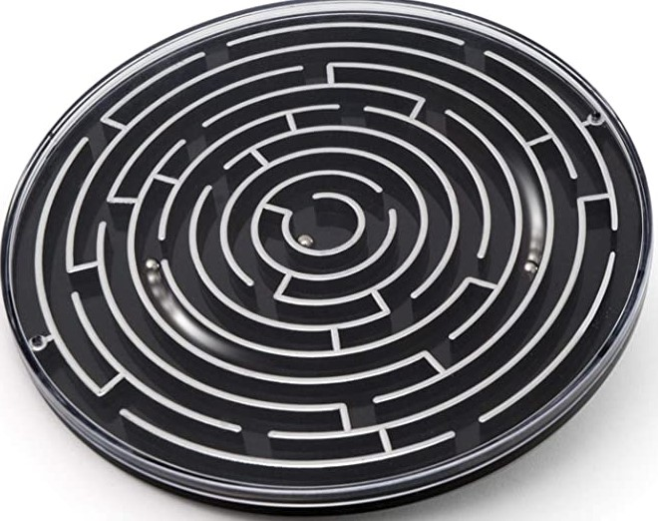
Randomness
The algorithm lines 11 and 12 have a “random (re)start”.
Start off randomly.
If you get “stuck”, try another random restart
Like shaking up a toy maze when you can’t get anywhere.
The local search in lines 13-15 can be intentional or random
“Random walk”
Needs stopping criterion in absence of solution.
Or improved solution

Slide 21
Example: Planning Your Degree
Assume that you have a bachelor’s degree in something, with Math coursework up through precalculus.
So all you need to take are the required CS courses + Calculus and Discrete Math.
Math is green, ICS is blue.
You want to finish in 6 semesters.
Crs | 210 | 215 | 140 | 141 | 232 | 240 | 311 | 340 | 365 | 372 | 440 | 460 | 462 | 499

Slide 22
Local Search for CSPs
Aim: Find an assignment with zero unsatisfied constraints
Given an assignment of a value to each variable, a conflict is an unsatisfied constraint
The goal is an assignment with zero conflicts
Heuristic function to be minimized: number of conflicts

Slide 23
Example: Random Beginning
To start local search, you could choose a random beginning assignment.
Or maybe you already did arc consistency and you have some good guesses as to what to assign where.
Each number is a proposed semester, chosen randomly from 1 to 6.
This example isn’t totally random, to keep the number of conflicts manageable visually.
Try Iterative Best Improvement (discrete domain)
Crs | 210 | 215 | 140 | 141 | 232 | 240 | 311 | 340 | 365 | 372 | 440 | 460 | 462 | 499
Sm | 3 | 2 | 1 | 2 | 2 | 5 | 5 | 6 | 3 | 2 | 3 | 6 | 4 | 3

Slide 24
Iterative Best Improvement Options
To choose a variable to change, and a new value for it
Find a variable-value pair that minimizes the number of conflicts
Select a variable that participates in the most conflicts. Select a value that minimizes the number of conflicts.
Select a variable that appears in any conflict. Select a value that minimizes the number of conflicts.
Select a variable at random. Select a value that minimizes the number of conflicts.
Select a variable and value at random; accept this change if it doesn’t increase the number of conflicts.

Slide 25
Notes on IBI
Sometimes you will choose the best change even when it adds to the number of conflicts
Otherwise you may find yourself stuck in a local extremum
For large search spaces you may not be able to test every variable or variable/value pair.
Maybe you only check variables “near” your present assignment.

Slide 26
Example: Random Beginning
To start local search, you could choose a random beginning.
Each number is a proposed semester, chosen randomly from 1 to 6.
This example isn’t totally random, to keep the number of conflicts manageable visually.
Strategy: Choose variable with most conflicts, and replace it with value that minimizes conflicts.
To be continued…
Crs | 210 | 215 | 140 | 141 | 232 | 240 | 311 | 340 | 365 | 372 | 440 | 460 | 462 | 499
Sm | 3 | 2 | 1 | 2 | 2 | 5 | 5 | 6 | 3 | 2 | 3 | 6 | 4 | 3

Slide 27
Complex Domains
When the domains are small or unordered, the neighbors of an assignment can correspond to choosing another value for one of the variables.
When the domains are large and ordered, the neighbors of an assignment are the adjacent values for one of the variables.
If the domains are continuous, Gradient descent changes each variable proportional to the gradient of the heuristic function h in that direction.
The value of variable X_{i} goes from v_{i} to
In this equation, η is the step size.

Slide 28
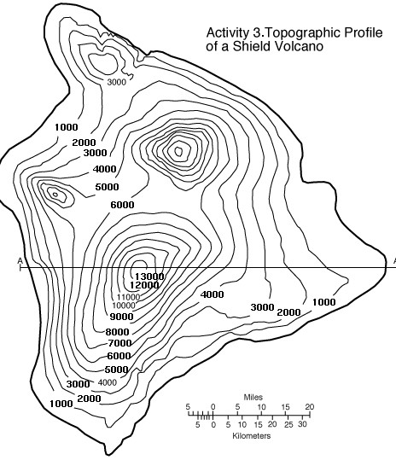
Problems with Greedy Descent/I.B.I.
Local extrema may not be global extrema
Plateau where heuristic values are uninformative
Ridge where n-step look-ahead might help

Slide 29
Randomized Algorithms
Consider two methods to find a minimum value:
Greedy descent, starting from some position, keep moving down and report minimum value found
Pick values at random and report minimum value found
Which do you expect to work better to find a global minimum?
Can a mix work better?

Slide 30
Randomized Greedy Descent
As well as downward steps we can allow for:
Random steps: move to a random neighbor
Random restart: reassign random values to all variables. Which is more expensive computationally?

